Slide 1

Application Insights telemetry for Business Central Partners
“It’s as simple as 1, 2, 3”
Notes:
Photo: https://www.pexels.com/photo/brown-firewood-122588/

Slide 2
In this presentation, you will learn about…
What is Azure Application Insights?
Azure Application Insights for partners (end to end)
Setup
Discover
Visualize, monitor, and alert
Troubleshoot using telemetry
New skills needed
What signal is currently available?

Slide 3

What is Azure Monitor (Application Insights)?
Notes:
https://docs.microsoft.com/en-us/azure/azure-monitor/overview

Slide 4

Main use cases for Business Central partners
Setup
Monitor
Troubleshoot
Mitigate
Notes:
Picture: https://www.pexels.com/photo/photo-of-woodpile-1787035/

Slide 5
Characteristics of partner telemetry
Treated as an API
Discoverable in docs
Documented in docs
Actionable
(if possible)

Slide 6
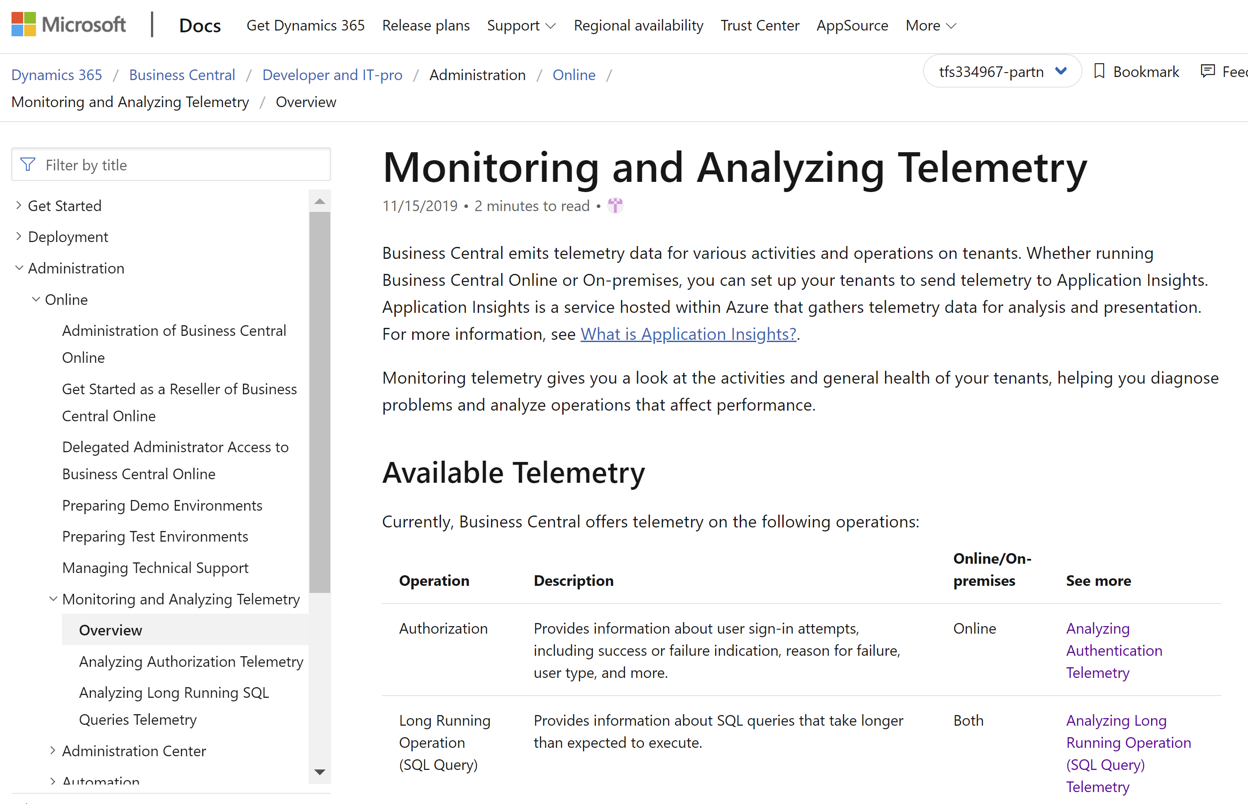
Landing page in docs aka.ms/bctelemetry
Notes:
https://docs.microsoft.com/en-us/dynamics365/business-central/dev-itpro/administration/telemetry-overview
or aka.ms/bctelemetry

Slide 7
It’s as simple as 1, 2, 3
Set up AppInsights for one or more environments
1
Deploy dashboards from the samples site
2
Monitor your environments
3
Notes:
High-level takeaway

Slide 8
To get telemetry, you need to do two things
Create an Application Insights resource in Azure
Configure Business Central environments in the Tenant Admin Center

Slide 9
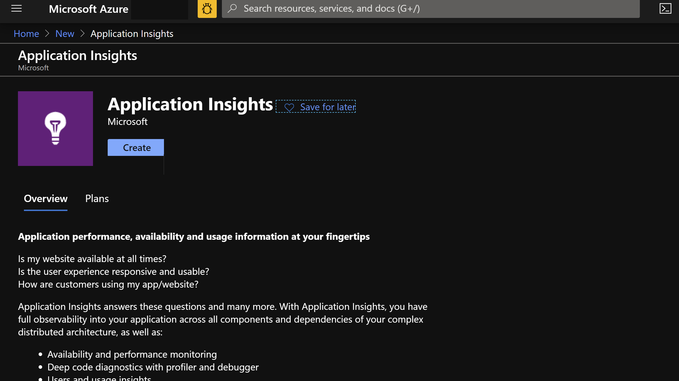

Slide 10
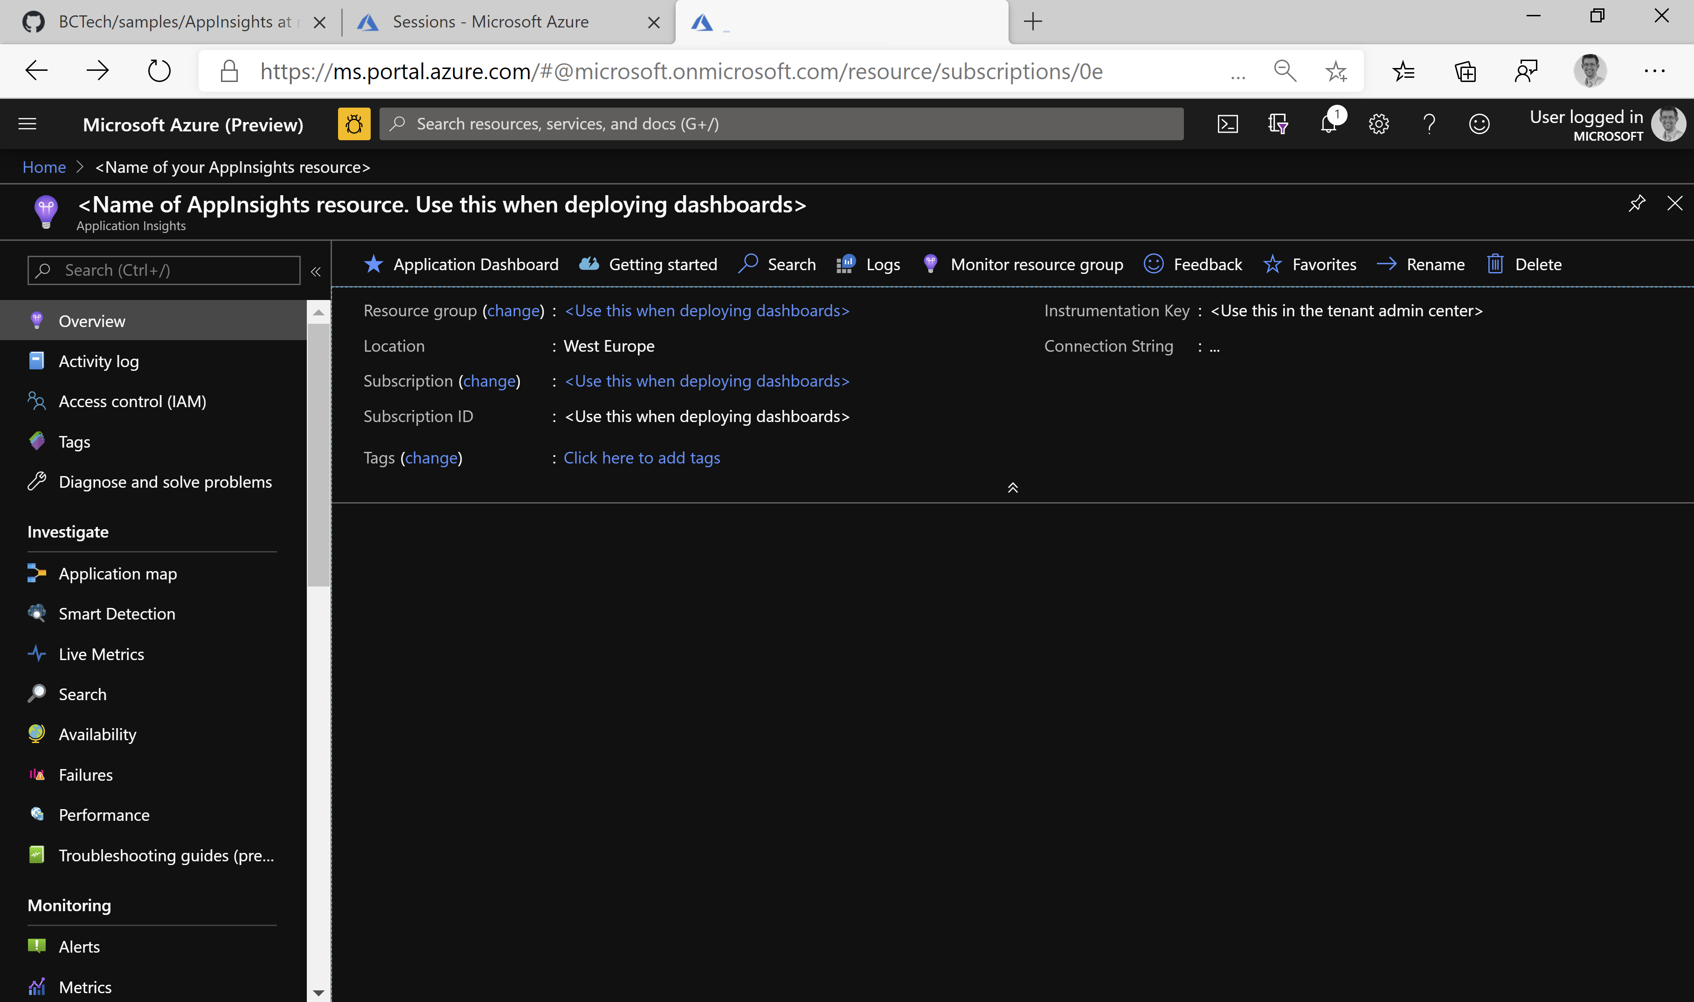

Slide 11
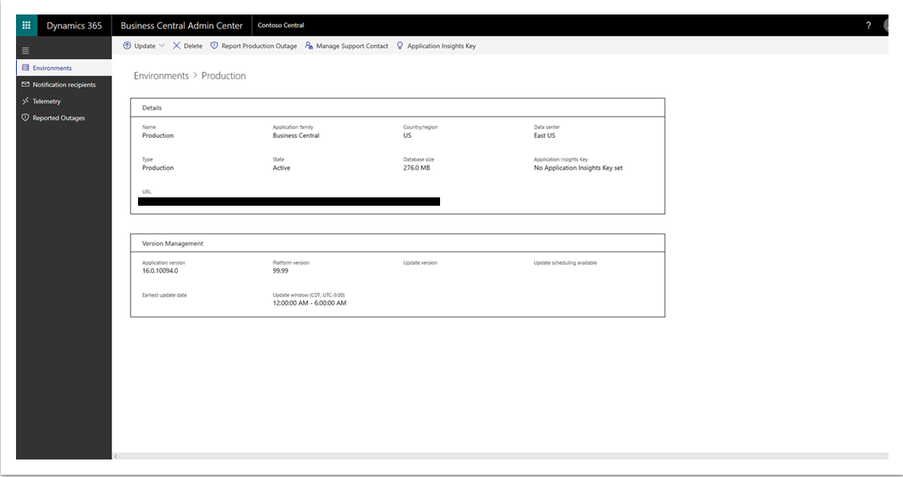
Notes:
App Insights key is per environment. This is BYO (Bring Your Own) AppInsights
See
https://docs.microsoft.com/en-us/dynamics365/business-central/dev-itpro/administration/tenant-admin-center-telemetry#sending-telemetry-to-microsoft-azure-application-insights

Slide 12
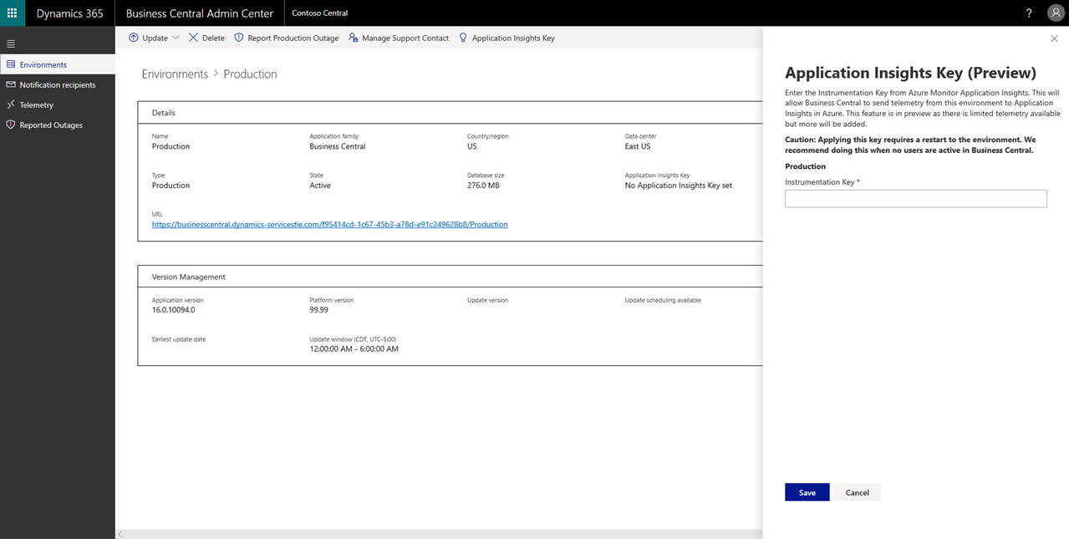
Notes:
Caution: will require a tenant environment restart. Do it off-hours (will cancel all sessions), takes 1-2 minutes to get the environment back online

Slide 13
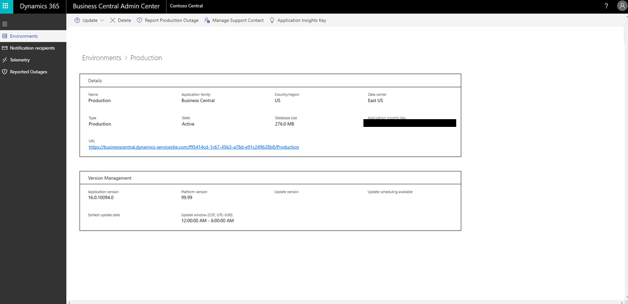
Notes:
Now the instrumentation key is registered with the application servers (NSTs)

Slide 14
Works also on-prem
Use Powershell cmdlets to inject Application Insights key into the NST
Single Tenant mode (2019 release wave 2, CU1)
Set-NAVServerConfiguration
-KeyName ApplicationInsightsInstrumentationKey -KeyValue <guid>
-ApplyTo All -ServerInstance <instance name>
Multi Tenant mode (2019 release wave 2)
Mount-NAVTenant -AadTenantId <aad guid>
-DatabaseName <database name> -Id <tenant id>
-DisplayName <tenant name>
-ApplicationInsightsKey <guid>
Notes:
See
https://docs.microsoft.com/en-us/dynamics365/business-central/dev-itpro/administration/telemetry-enable-application-insights

Slide 15

Setup scenarios for partners
One Application Insights account can be used for many environments.
Imagine a partner managing 100 environments for 40 different customers.
Maybe one Application Insights for prod, one for sandboxes
Or select customers want to use their own
Notes:
Picture: https://www.pexels.com/photo/assortment-black-and-white-black-and-white-chrome-220639/

Slide 16
How to visualize data from Application Insights
Use Azure dashboards (demo)
https://docs.microsoft.com/en-us/azure/azure-monitor/learn/tutorial-app-dashboards#add-logs-analytics-query
Use PowerBI
https://docs.microsoft.com/en-us/azure/azure-monitor/app/export-power-bi
Use Jupyter/Azure Monitor workbooks
https://docs.microsoft.com/en-us/azure/azure-monitor/app/usage-workbooks
Notes:
https://docs.microsoft.com/en-us/azure/azure-monitor/learn/tutorial-app-dashboards#add-logs-analytics-query

Slide 17
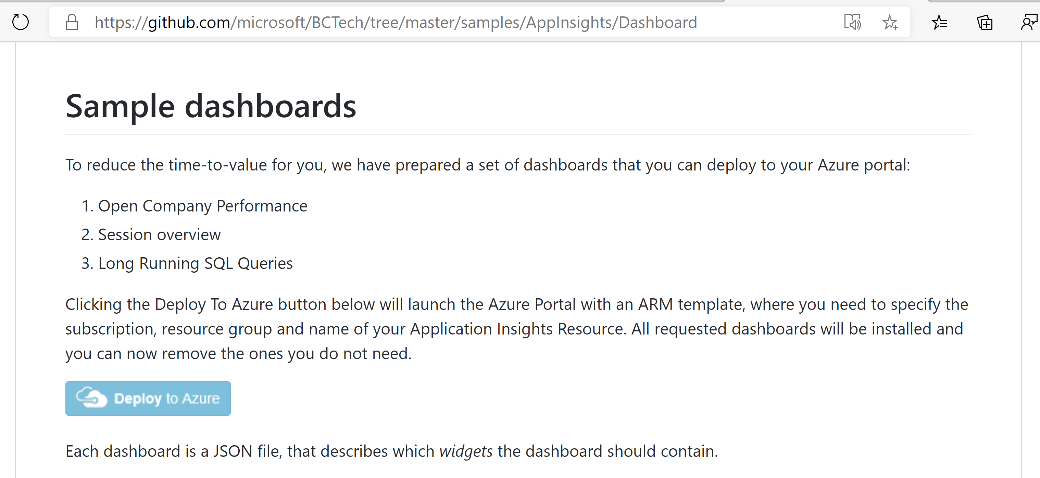
How to deploy sample dashboards
Notes:
https://github.com/microsoft/BCTech/tree/master/samples/AppInsights/Dashboard

Slide 18
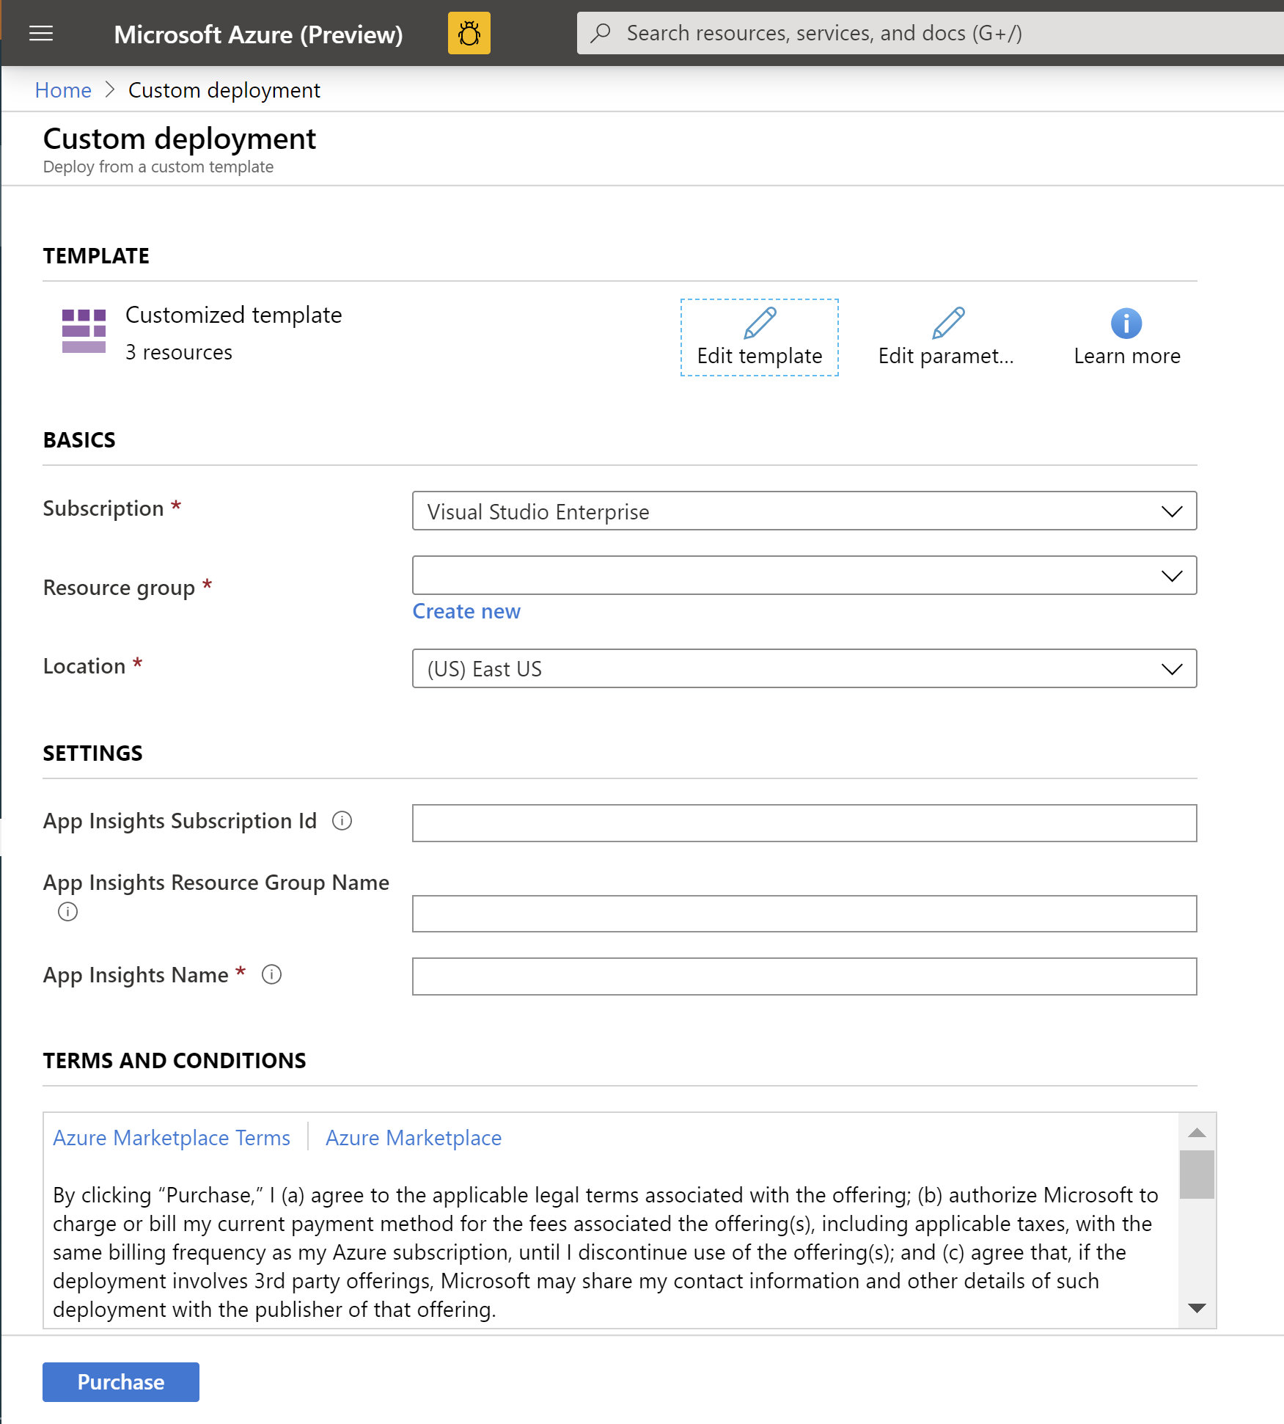
Fill in the deployment template and click “Purchase”

Slide 19
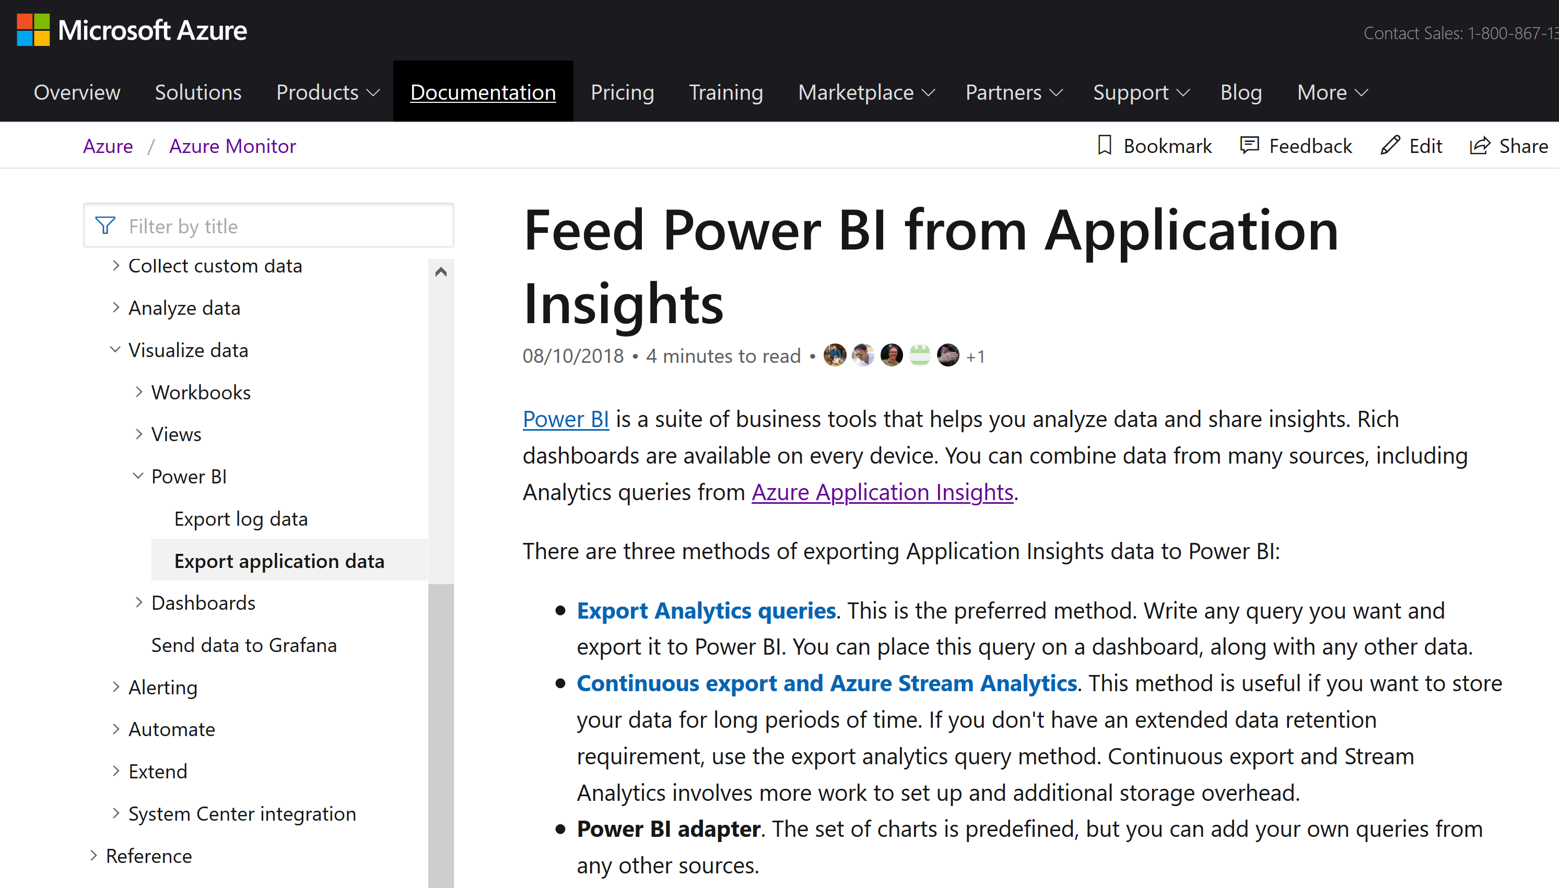
How to connect PowerBI to Application Insights
Notes:
https://docs.microsoft.com/en-us/azure/azure-monitor/app/export-power-bi

Slide 20
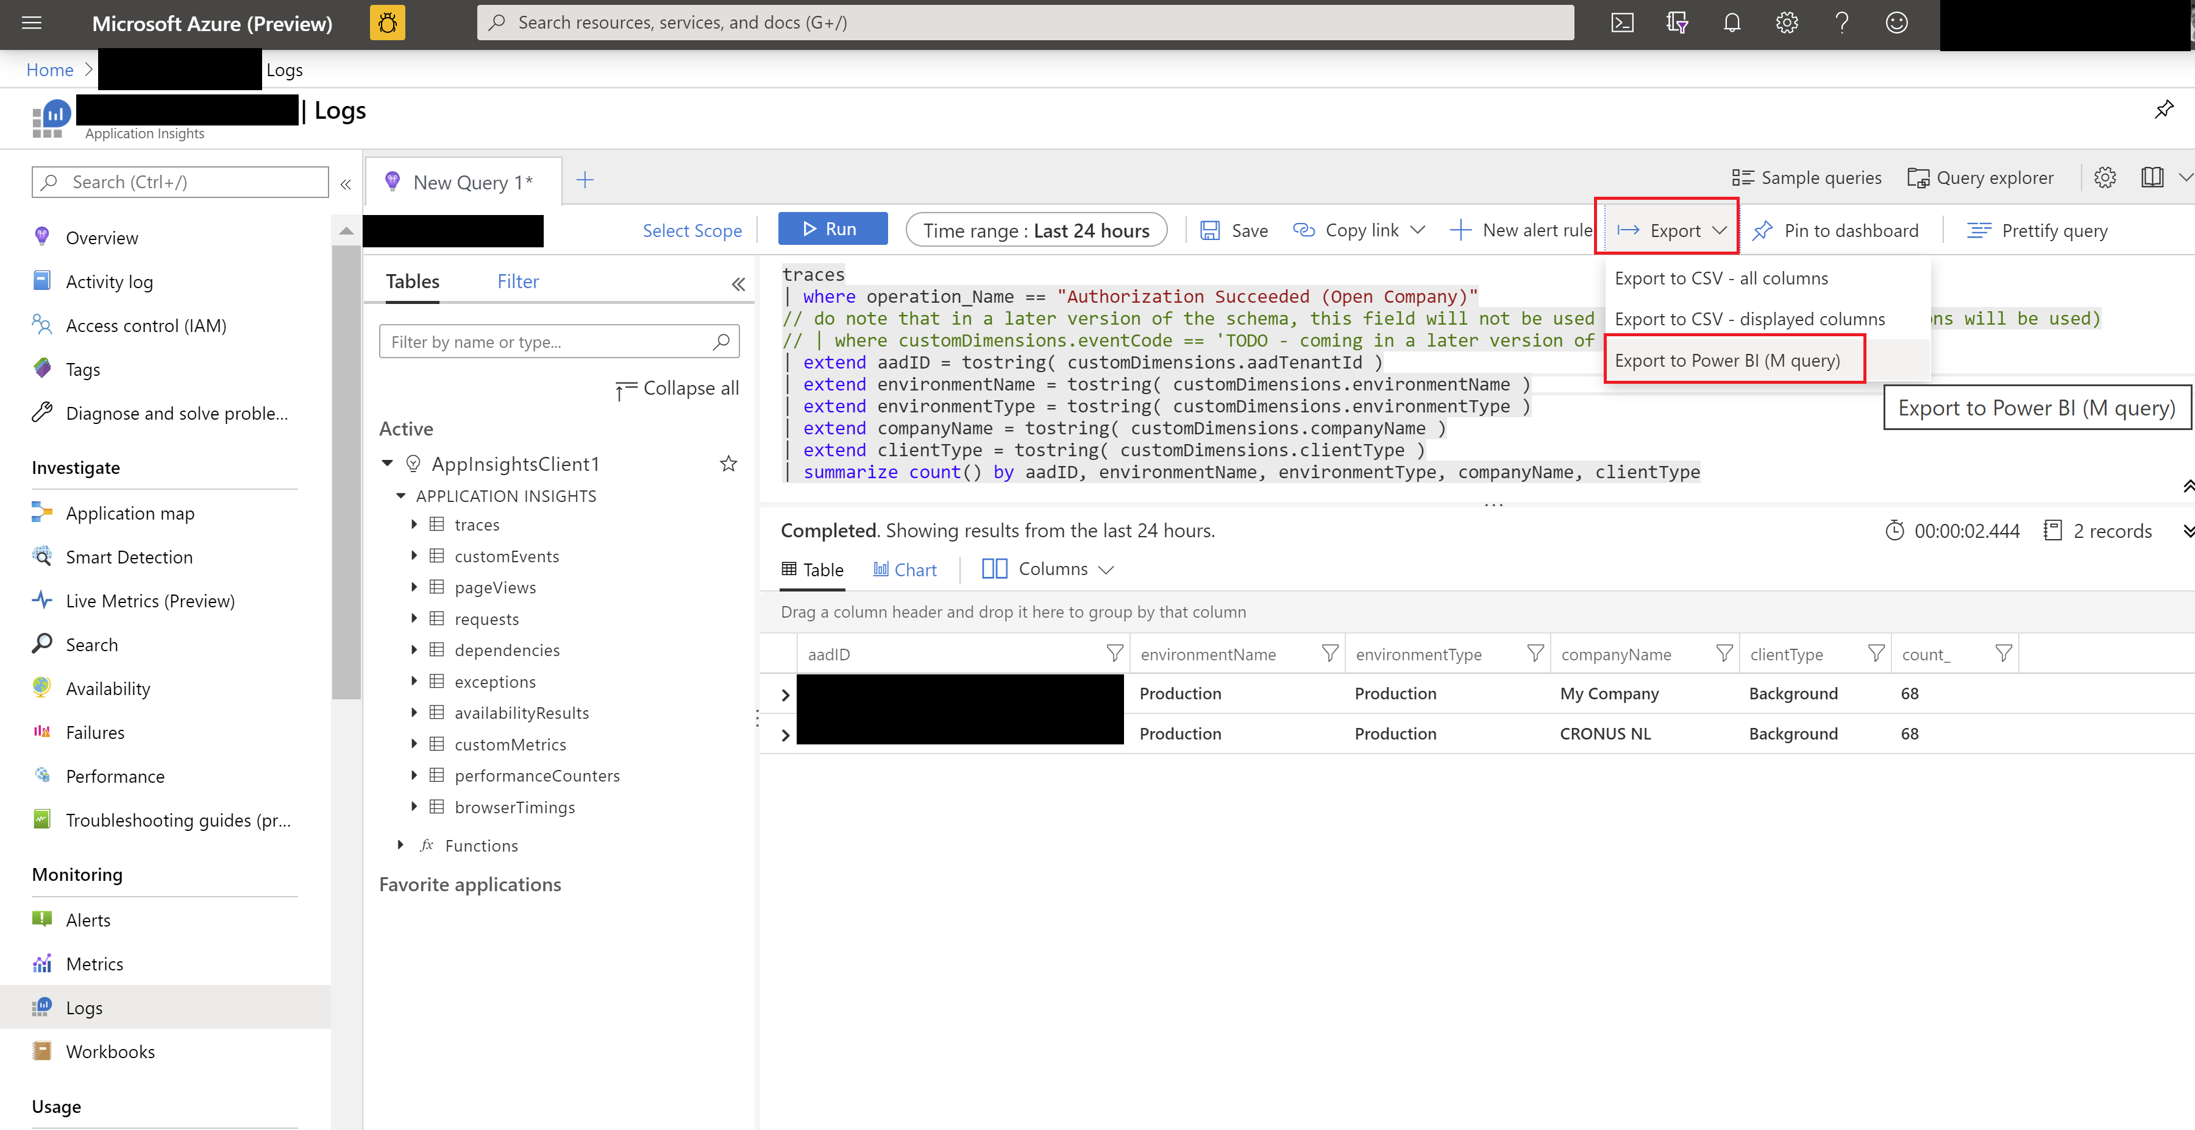
Export KQL query to M query (to be used in PowerBI)

Slide 21
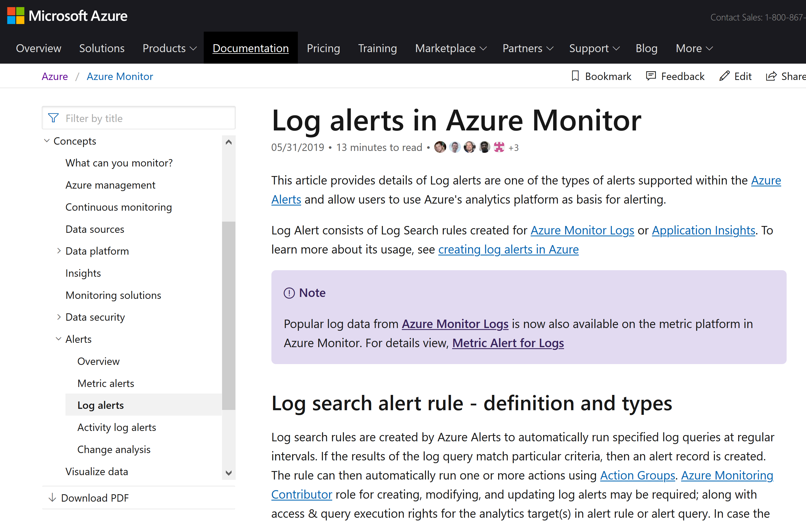
How to set up log alerts in Azure Monitor based on a Kusto query
Notes:
https://docs.microsoft.com/en-us/azure/azure-monitor/platform/alerts-unified-log

Slide 22
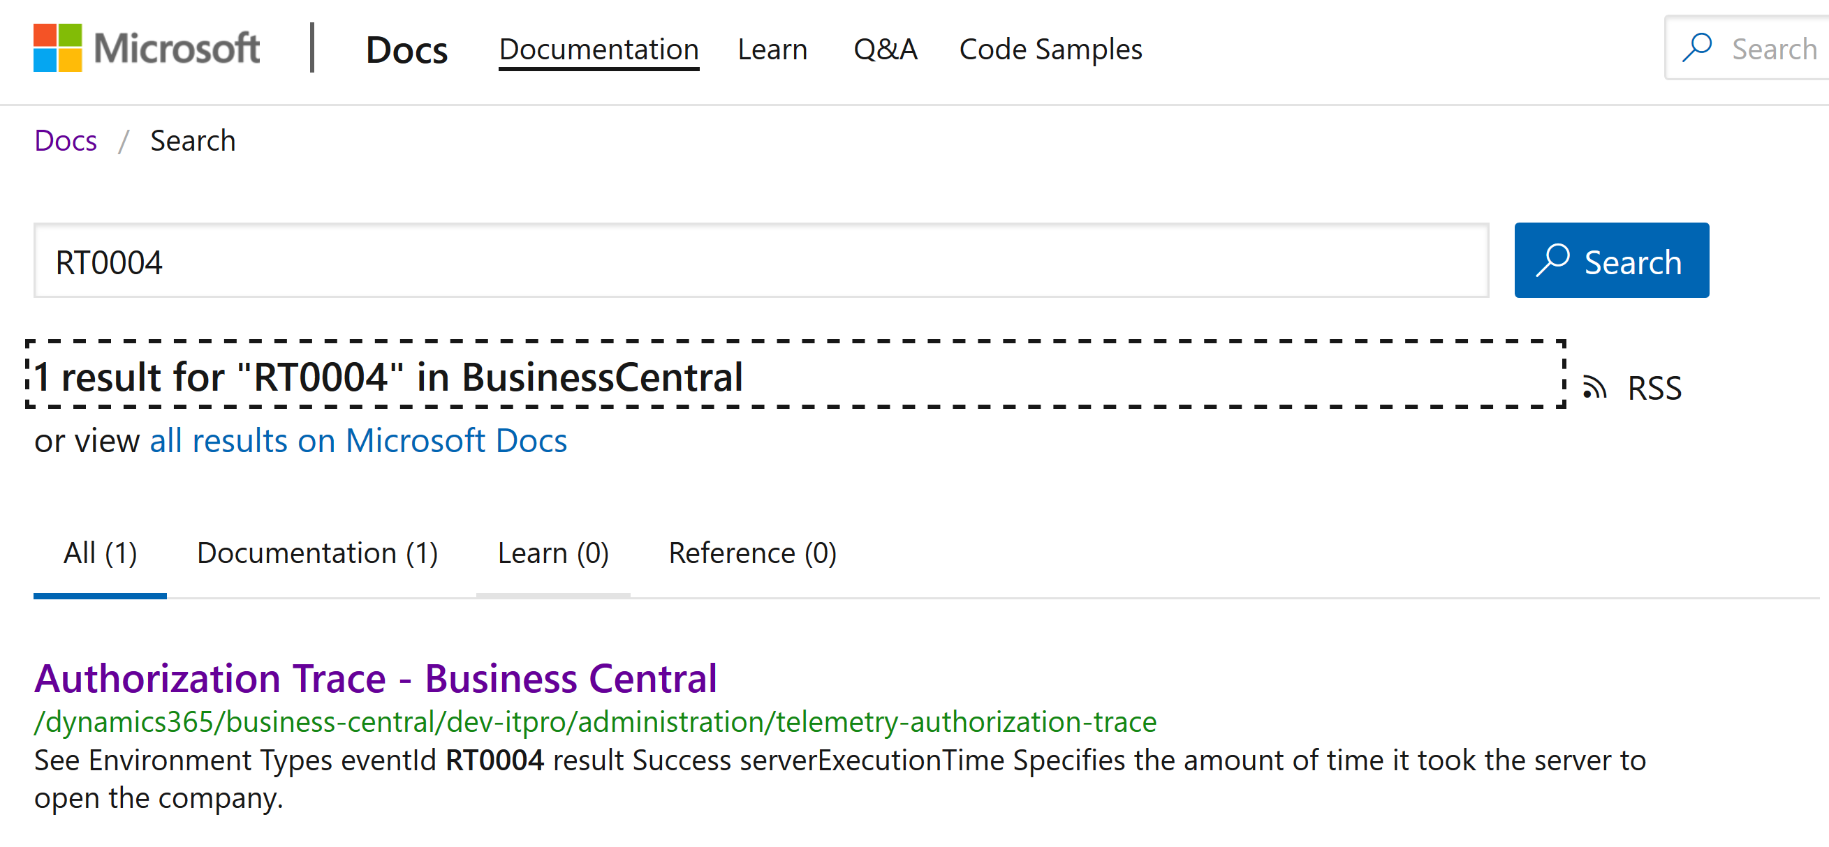
Search for documentation using the eventId
Notes:
We added a new custom dimension: eventId to #msdyn365bc partner telemetry in version 16.1

Slide 23
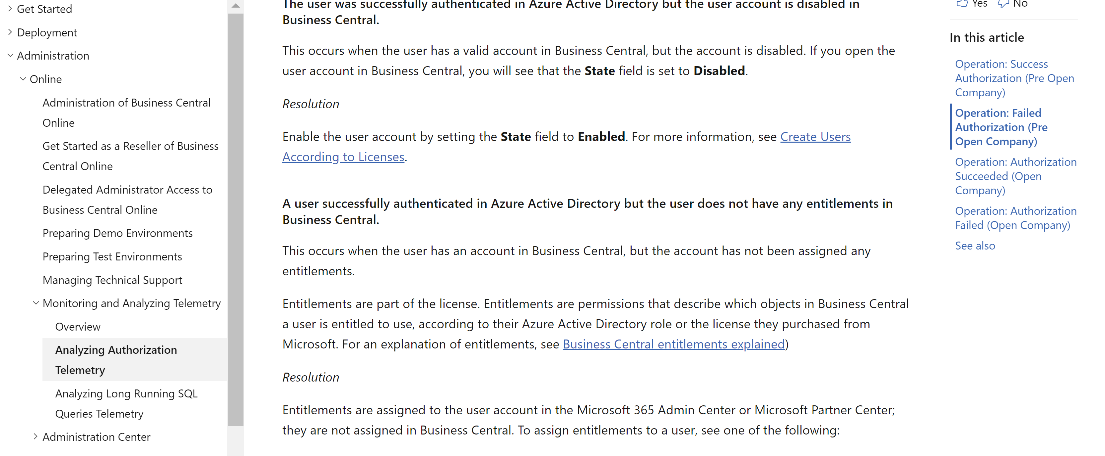
Example: Trouble Shooting Guide (TSG) on login failures (in docs)
Notes:
Authorization signal added in 15.3
https://docs.microsoft.com/en-us/dynamics365/business-central/dev-itpro/administration/telemetry-authorization-trace

Slide 24
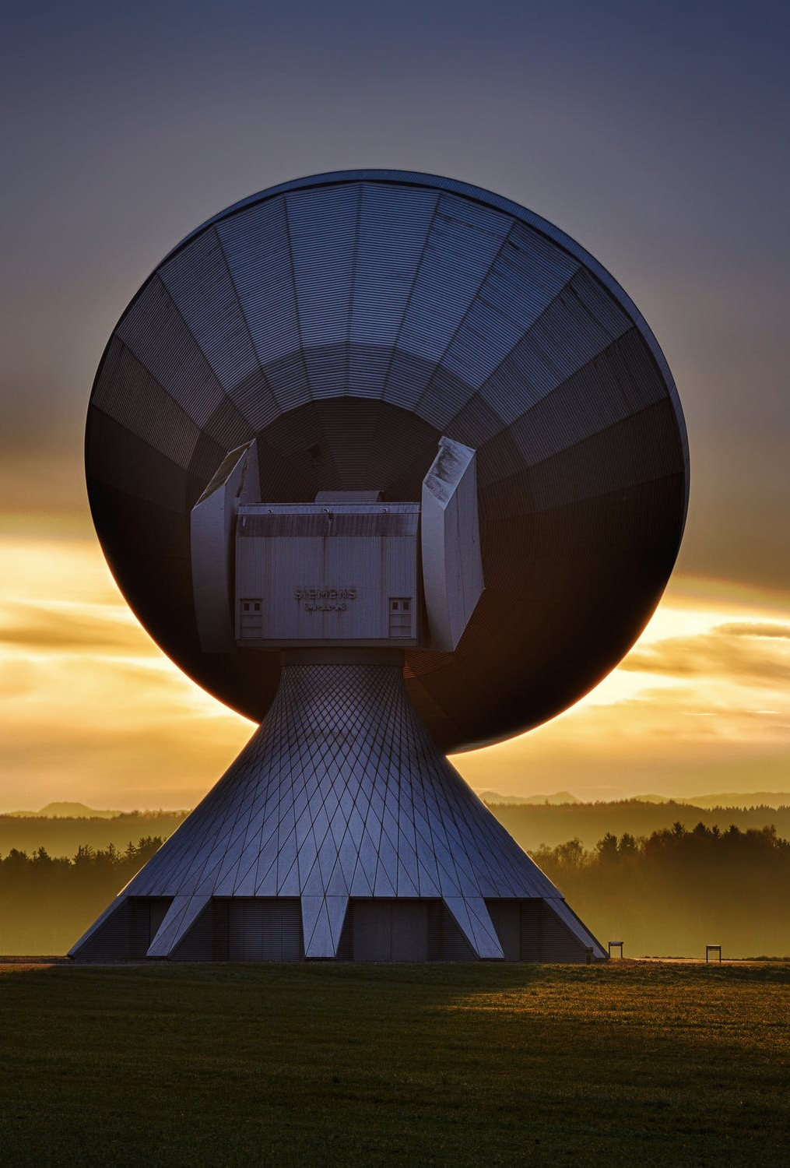
Example: What can you infer from web service signal?
Many messages where endpoint contains “powerbi” => excessive powerBI reports
If start message + long running sql query + end message => maybe need to adjust/tune codeunit
If many 429 (Too Many Requests) => adjust client consuming web service end point
If many 500 (Timeout) => Tune code unit/page
If many requests <> API type => uptake API pages to get better perf
If start message but no end message => exception raised in codeunit
Notes:
Web service signal added in 16.0
Picture: https://www.pexels.com/photo/antenna-contact-dawn-dusk-33153/

Slide 25

New skills needed for partners
Learn KQL
Learn about Azure Monitor
Think more like livesite
Get acquainted with TSGs on docs
Notes:
Picture: https://www.pexels.com/photo/man-grinding-metal-3484702/

Slide 26
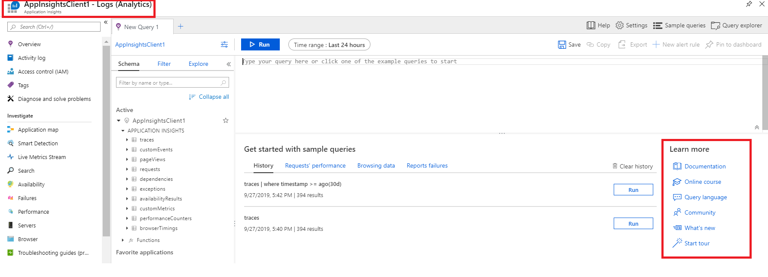
Kusto Query Language (KQL)

Slide 27
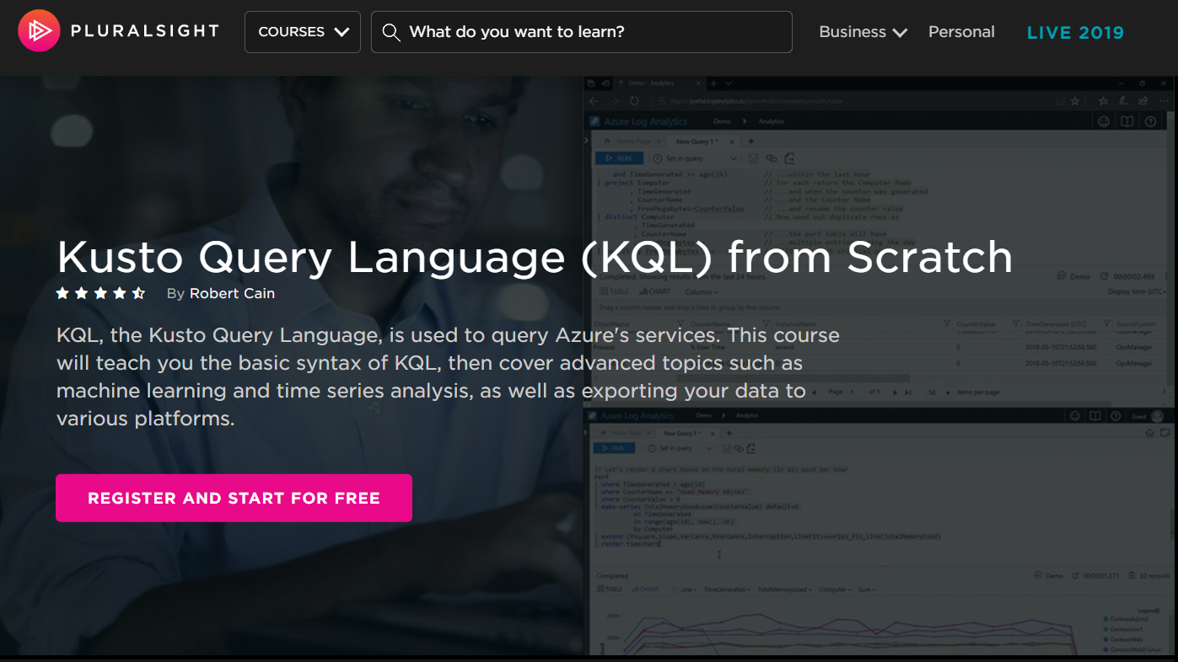
Notes:
Example query:
traces
| extend clienttype = tostring(customDimensions.['Client type'])
| where timestamp >= ago(30d)
| project timestamp, clienttype , customDimensions , AADTenantId=cloud_RoleName

Slide 28
Available signal
2019 release wave 2: Long Running SQL Queries
2019 release wave 2 update 3: Authorization
2020 release wave 1: Web Service Requests
2020 release wave 1: Report execution
2020 release wave 1: Open Company Timings
2020 release wave 1 update 1: Company Lifecycle
2020 release wave 1 update 1: Update Failures
Notes:
See samples and schedule here: https://github.com/microsoft/BCTech/tree/master/samples/AppInsights/KQL
Docs overview: https://docs.microsoft.com/en-us/dynamics365/business-central/dev-itpro/administration/telemetry-overview
Picture:
https://www.pexels.com/photo/ocean-wave-1656579/

Slide 29
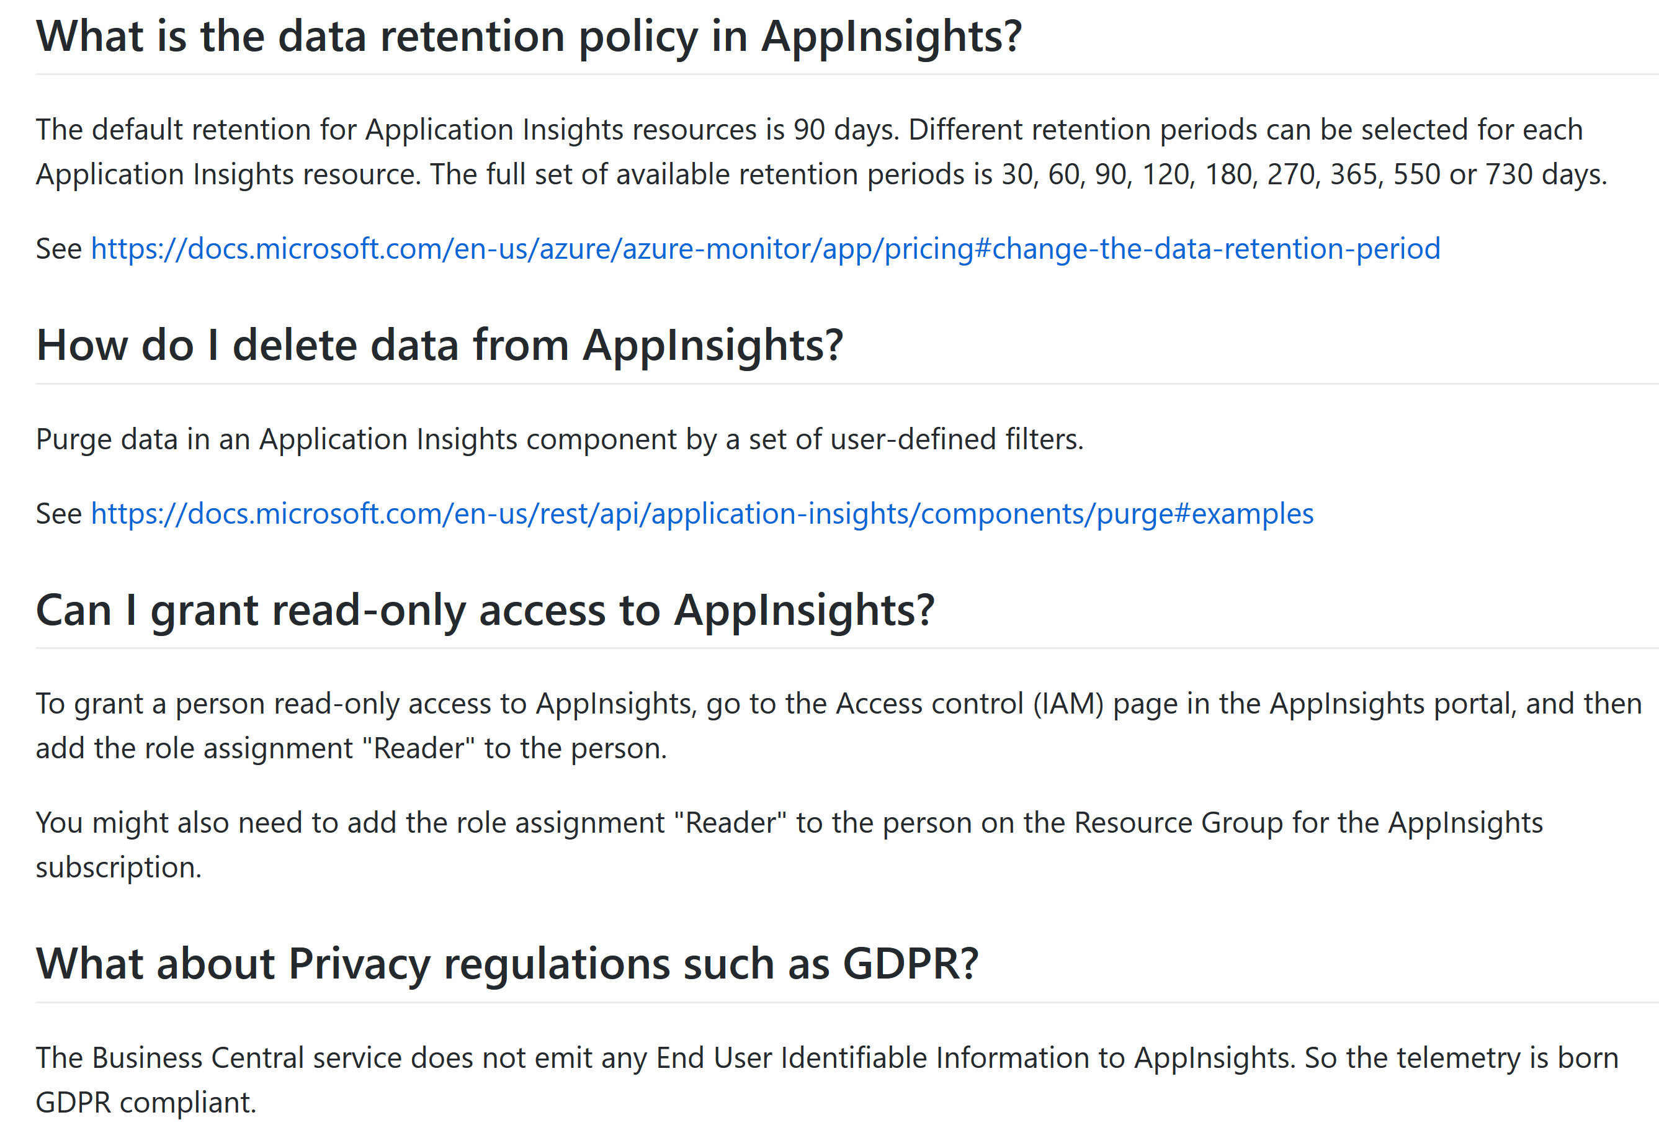
FAQ
Notes:
https://github.com/microsoft/BCTech/blob/master/samples/AppInsights/FAQ.md

Slide 30
Links
About Azure Monitor/Application Insights
https://aka.ms/azuremonitor
Setup Business Central to emit telemetry to Azure Application Insights
https://aka.ms/bctelemetry
Telemetry signal overview
https://aka.ms/bctelemetry
Samples
https://aka.ms/bctelemetrysamples

